Slide 1
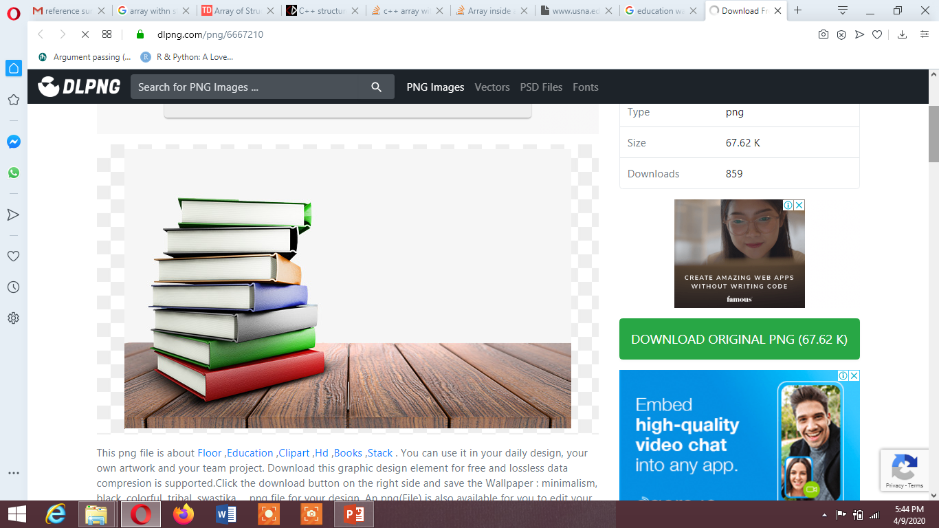
Amara Fida
Madina Khokhar
Aneeba Shezadi
Esha Mansoor

Slide 2

LAPLACE TRANSFORM
Why called Laplace Transform ? Why Study Laplace Transform ? Defination Laplace Transform ?

Slide 3
WHY CALLED LAPLACE TRANSFORM
Laplace : Mathematician Name
Transform: one variable change into another variable (s variable change
into t and t change into s)
Why Study Laplace Transform
Solve initial value problem
Solve Linear Differential Equation (solve in minimum steps)
Defination
The Laplace Transform is a linear operator that switched a
function f(t) to f(s).

Slide 4
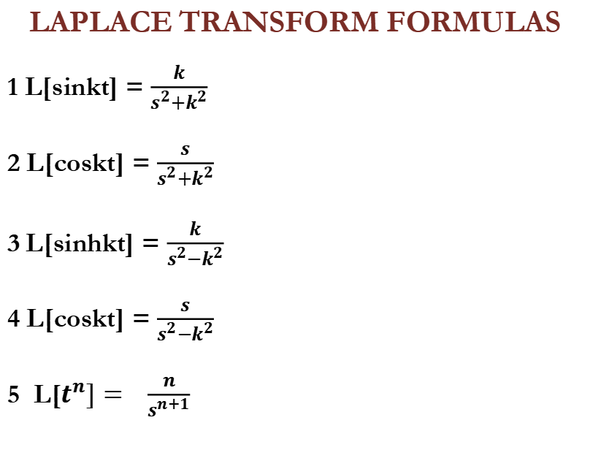
LAPLACE TRANSFORM FORMULAS
1 L[sinkt] = $\frac{k}{s^{2}+k^{2}}$
2 L[coskt] = $\frac{s}{s^{2}+k^{2}}$
3 L[sinhkt] = $\frac{k}{s^{2}−k^{2}}$
4 L[coskt] = $\frac{s}{s^{2}−k^{2}}$
5 L[$t^{n}]= \frac{n}{s^{n+1}}$

Slide 5

LAPLACE TRANSFORM
PROOF:
F(t)=$e^{at}$
L[$e^{at}]=\int_{0}^{∞}{{ e^{−st} e}^{at} dt}$
L[$e^{at}]=\int_{0}^{∞}{{ e}^{−st+at} dt}$
L[$e^{at}]=\int_{0}^{∞}{{ e}^{−t(s−a)} dt}$
L[$e^{at}]=$ $\frac{{ e}^{−t(s−a)}}{−(s−a)} dt$
L[$e^{at}]=$ $−\frac{1}{(s−a)} \left(0−1\right) =\frac{1}{s−a}$

Slide 6
PROPERTIES OF LAPLACE TRANSFORM :
Linear Property
First Shifting Property
Division Property

Slide 7
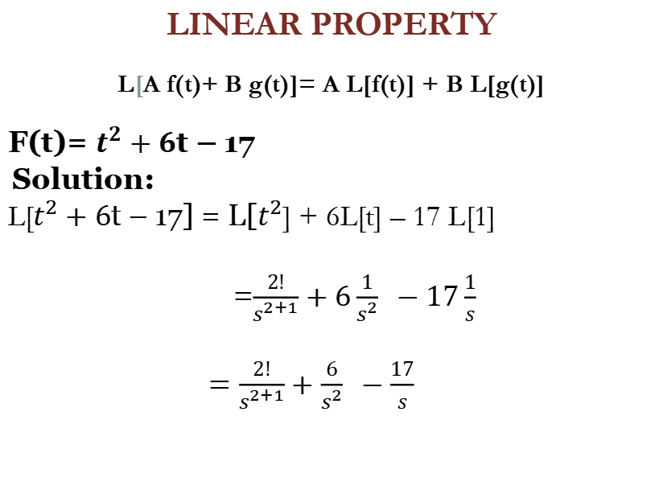
LINEAR PROPERTY
L[A f(t)+ B g(t)]= A L[f(t)] + B L[g(t)]
F(t)= $t^{2}+6$t – 17
Solution:
L[$t^{2}+6$t – 17] = L[$t^{2}$] + 6L[t] – 17 L[1]
=$\frac{2!}{s^{2+1}}+6\frac{1}{s^{2}} −17\frac{1}{s}$
$=\frac{2!}{s^{2+1}}+\frac{6}{s^{2}} −\frac{17}{s}$

Slide 8
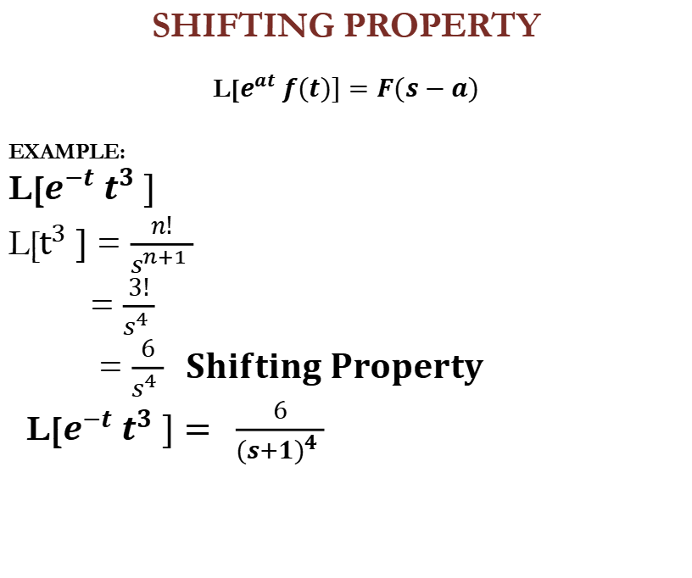
SHIFTING PROPERTY
L[$e^{at} f(t)]=F(s−a)$
EXAMPLE:
L[$e^{−t} t^{3} ]$
L[$t^{3} ]$ = $\frac{n!}{s^{n+1} }$
= $\frac{3!}{s^{4} }$
= $\frac{6}{s^{4} } Shifting Property$
L[$e^{−t} t^{3} ]= \frac{6}{({s+1)}^{4} }$

Slide 9
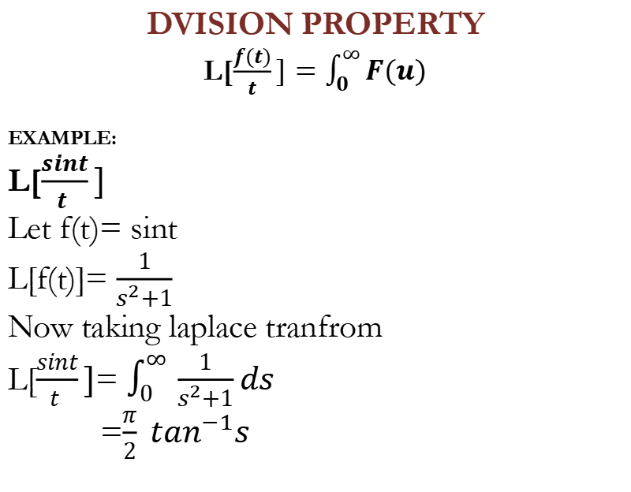
DVISION PROPERTY
L[$\frac{f(t)}{t}]=\int_{0}^{∞}{F(u)}$
EXAMPLE:
L[$\frac{sint}{t }]$
Let f(t)= sint
L[f(t)]= $\frac{1}{s^{2}+1}$
Now taking laplace tranfrom
L[$\frac{sint}{t }]$= $\int_{0}^{∞ }{\frac{1}{s^{2}+1}ds}$
=$\frac{π}{2} \tan^{−1}s$

Slide 10
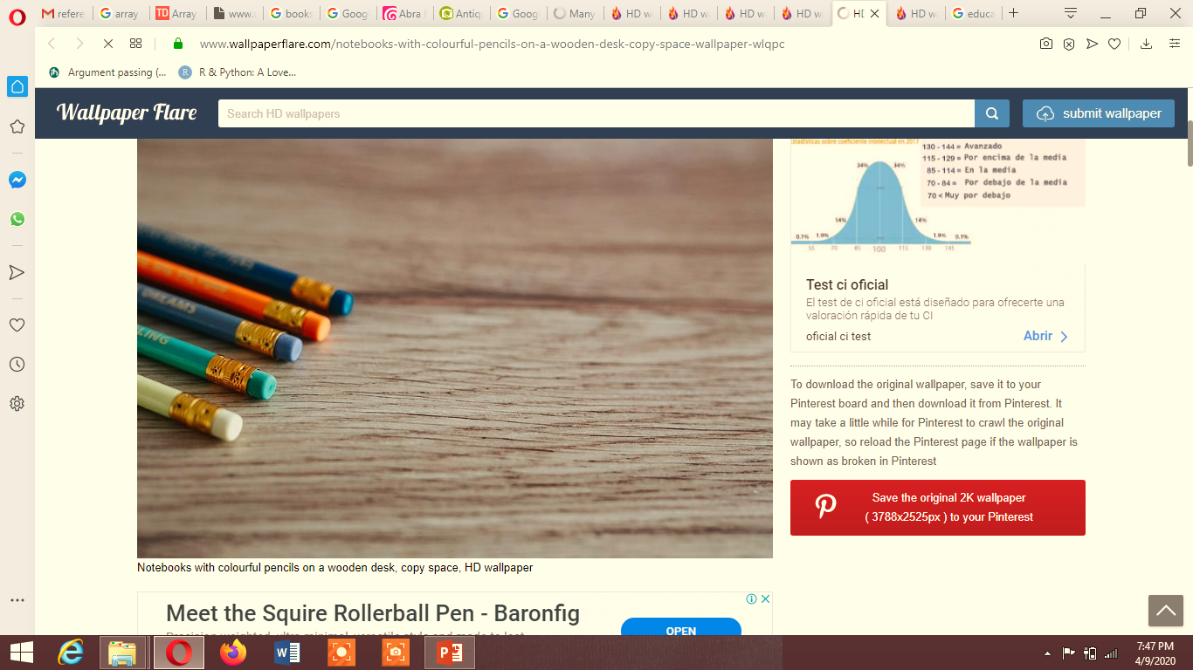
Inverse Laplace

Slide 11
Definition:
The inverse Laplace transform definition comes as the inverse operation of the Laplace transformation and is mathematically is written as:
f=L−1(F).

Slide 12
LAPLACE INVERSE
In Laplace Transform
T variable change into S variable
In Laplace Inverse
S variable change into T variable

Slide 13
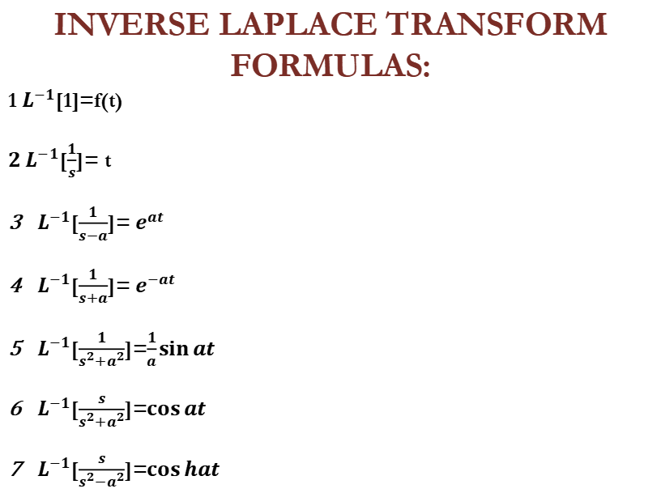
INVERSE LAPLACE TRANSFORM FORMULAS:
1 $L^{−1}$[1]=f(t)
$2 L^{−1}$[$\frac{1}{s}$]= t
$L^{−1}$[$\frac{1}{s−a}$]= $e^{at}$
$L^{−1}$[$\frac{1}{s+a}$]= $e^{−at}$
$L^{−1}$[$\frac{1}{s^{2}+a^{2}}$]=$\frac{1}{a}\sin{at}$
$L^{−1}$[$\frac{s}{s^{2}+a^{2}}$]=$\cos{at}$
$L^{−1}$[$\frac{s}{s^{2}−a^{2}}$]=$\cos{hat}$

Slide 14
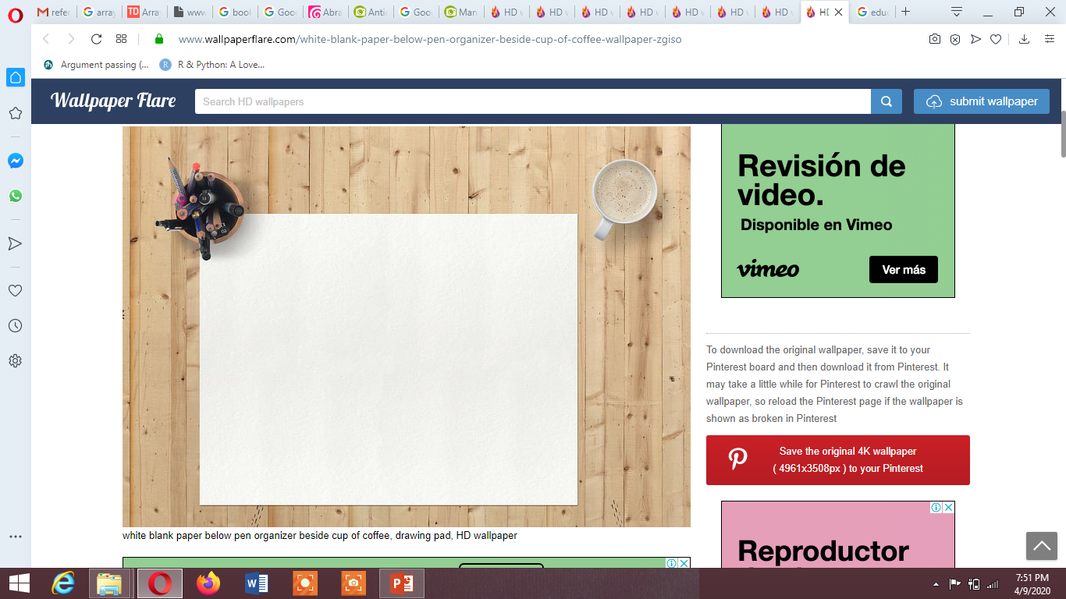
Solving ODE’S USING LAPLACE

Slide 15
SOLVING ODES USING LAPLACE:
The first step is to take the Laplace transform of both sides of the original differential equation
Put the initial value
Taking Inverse Laplace

Slide 16

EXAMPLE
$$\frac{dy}{dx} . ky=ce^{kt} y\left(0\right)=0$$
$\frac{dy}{dx} . ky=ce^{kt}$….. 1
Taking Laplace Transform
SY(S) – y(0) – KY(S) = c $\frac{1}{s−k}$
SY(S) – 0 – KY(S) = c $\frac{1}{s−k}$
SY(S) – KY(S) = c $\frac{1}{s−k}$

Slide 17

Y(S) (s –k) = c $\frac{1}{s−k}$
Y(S) = $\frac{c}{({s−k)}^{2}}$
Taking Inverse Laplace Transform
y(t) = c $L^{−1}$[$\frac{1}{({s−k)}^{2}}]$
y(t) = c $e^{kt}$

Slide 18
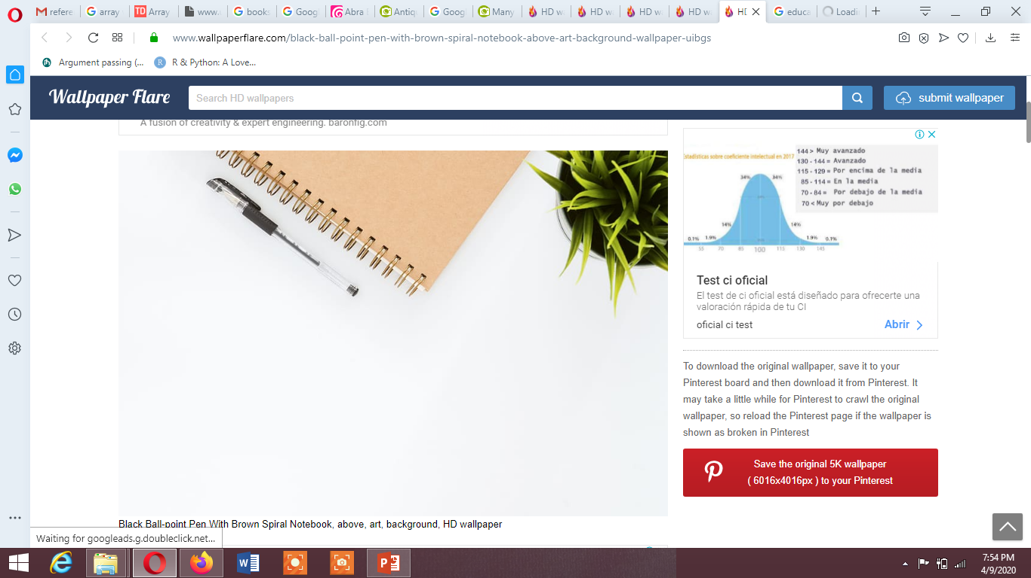
SOLVING PDES USING LAPLACE:

Slide 19
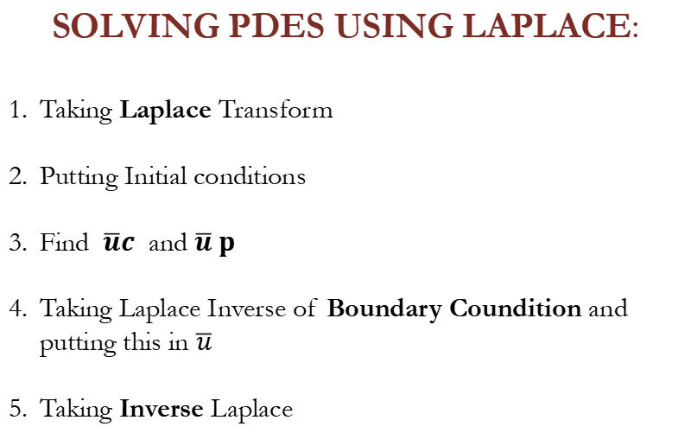
SOLVING PDES USING LAPLACE:
Taking Laplace Transform
Putting Initial conditions
Find $\overline{u}c$ and $\overline{u} p$
Taking Laplace Inverse of Boundary Coundition and putting this in $\overline{u}$
Taking Inverse Laplace

Slide 20
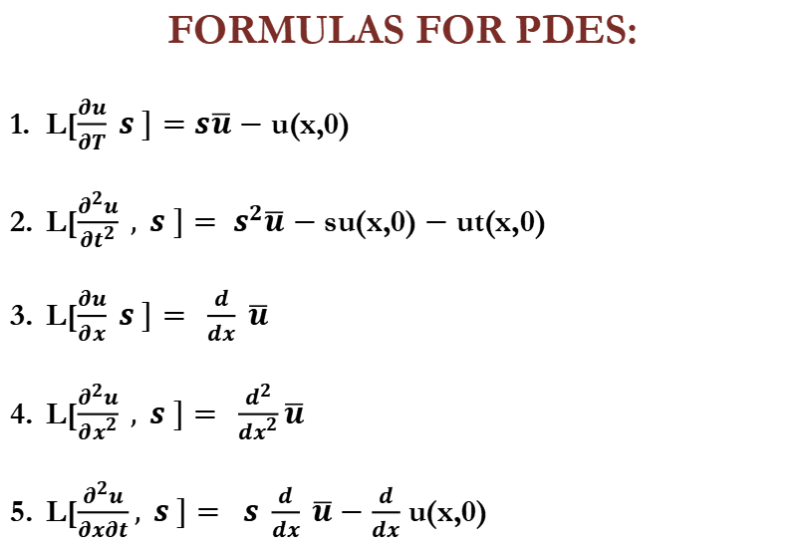
FORMULAS FOR PDES:
L[$\frac{∂u}{∂T} s ]=s\overline{u}$ $−$ u(x,0)
L[$\frac{∂^{2}u}{{∂t}^{2}} , s ]= s^{2}\overline{u}$ $−$ su(x,0) $−$ ut(x,0)
L[$\frac{∂u}{∂x} s ]= \frac{d}{dx} \overline{u}$
L[$\frac{∂^{2}u}{{∂x}^{2}} , s ]= \frac{d^{2}}{{dx}^{2}}\overline{u}$
L[$\frac{∂^{2}u}{∂x∂t}, s ]= s \frac{d}{dx} \overline{u}−$ $\frac{d}{dx}$ u(x,0)

Slide 21
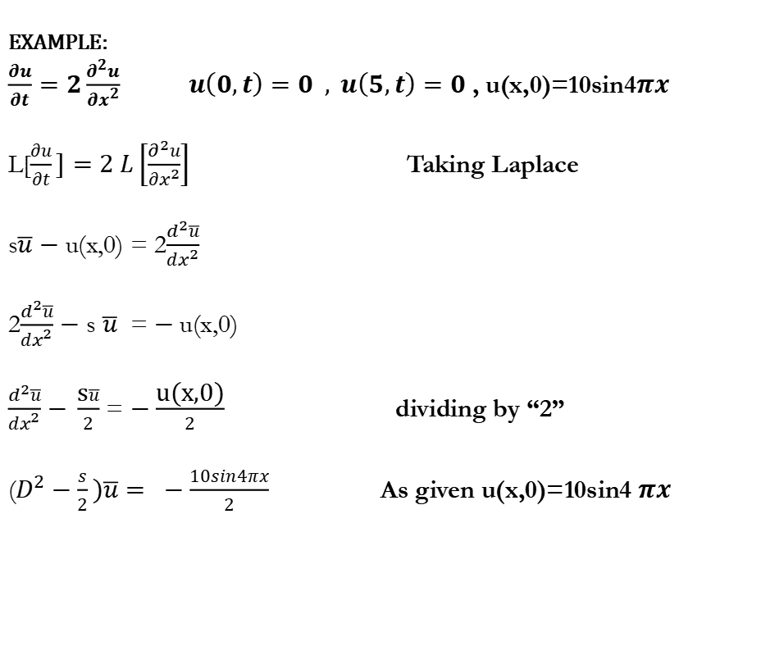
EXAMPLE:
$\frac{∂u}{∂t}=2\frac{∂^{2}u}{∂x^{2}} u\left(0,t\right)=0 , u\left(5,t\right)=0$ , u(x,0)=10sin4$πx$
L[$\frac{∂u}{∂t}]=2 L\left[\frac{∂^{2}u}{∂x^{2}}\right]$ Taking Laplace
s$\overline{u}$ $−$ u(x,0) = 2$\frac{d^{2}\overline{u}}{dx^{2}}$
2$\frac{d^{2}\overline{u}}{dx^{2}}$ $−$ s $\overline{u}$ = $−$u(x,0)
$\frac{d^{2}\overline{u}}{dx^{2}}$ $− \frac{\text{s}\overline{u}}{2}$ = $−\frac{\text{u}\text{(}\text{x}\text{,0)}}{2}$ dividing by “2”
($D^{2}−\frac{s}{2})\overline{u}= −\frac{10sin4πx}{2}$ As given u(x,0)=10sin4 $πx$

Slide 22

Charactertistic equation is
$m^{2}−\frac{s}{2}=0$
m = $− \sqrt{\frac{s}{2}} , +$ $\sqrt{\frac{s}{2}}$
$\overline{u}$c= c1$e^{\sqrt{\frac{s}{2}} \text{x}}+c2e^{−\sqrt{\frac{s}{2}} \text{x}}$
$\overline{u}$p= $\frac{−5sin4πx}{\text{(}D^{2}−\frac{s}{2})}$
$c$p= $\frac{1}{\text{(}−16π^{2}−\frac{s}{2})}$ $−5sin4πx$
$\overline{u}$p= $\frac{10sin4πx}{\text{(}s+32π^{2})}$

Slide 23
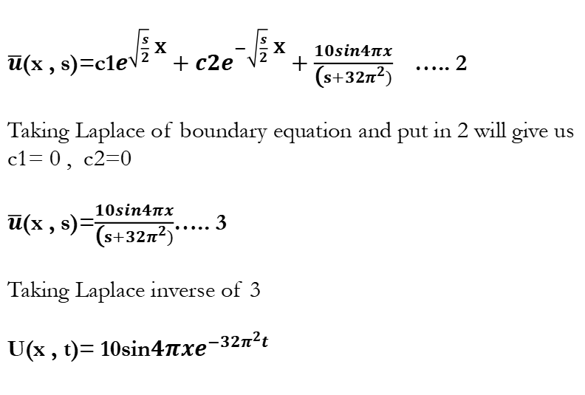
$\overline{u}$(x , s)=c1$e^{\sqrt{\frac{s}{2}} \text{x}}+c2e^{−\sqrt{\frac{s}{2}} \text{x}}+\frac{10sin4πx}{\text{(}s+32π^{2})}$ ….. 2
Taking Laplace of boundary equation and put in 2 will give us
c1= 0 , c2=0
$\overline{u}$(x , s)=$\frac{10sin4πx}{\text{(}s+32π^{2})}$….. 3
Taking Laplace inverse of 3
U(x , t)= 10sin$4πxe^{−32π^{2}t}$

Slide 24
THANK
YOU

